Slide 1

Two-Way ANOVA
Reading: 6.3 – 6.5,
7.4 – 7.6, 8.7
exercises: Ch 6. 38
ch 7. 34
Assigned: none
Producer: dr. mario
img credit: alex riegert-waters

Slide 2
Example: Grades on Different Exams
Data
Using One-Way ANOVA:
No Significant Differences Between Exams
Significant Differences Between Students
Question: Can we use both factors to explain variability in scores?
Barb Betsy Bill Bob Bud
Mean
72
87
68
73
75
62 94 68 86 50
87 95 93 97 63
74 86 82 70 28
77 89 73 79 47
Exam #1:
Exam #2:
Exam #3:
Exam #4:
Mean 75 91 79 83 47

Slide 3

Simple Block Design
Simple Block Design has two factors with exactly one observation in each combination of factors
Example: Examine Effect of Different Treatments at Different Severities
Factor A (Treatments) has I Levels
Factor B (Severity) has J Levels
Sample Size is $n=I∗J$ in a Simple Block Design
Question: What is the problem of this design?

Slide 4
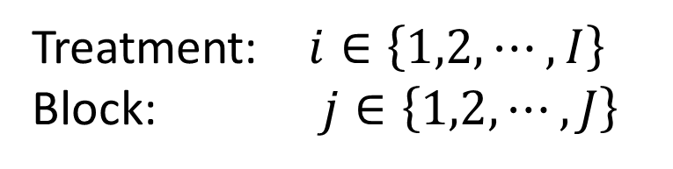
Two-Way ANOVA
Means Version
Effects Version (Additive)
Treatment: $i∈\left\{1,2, ⋯,I\right\}$
Block: $j∈\left\{1,2, ⋯,J\right\}$
$$Y=μ_{ij}+ε$$
Mean of Y for Treatment i and Block j
$$Y=μ+α_{i}+β_{j}+ε$$
Same Assumptions
About Error Term
Grand
Mean
Effect of Block j
Effect of Treatment i

Slide 5
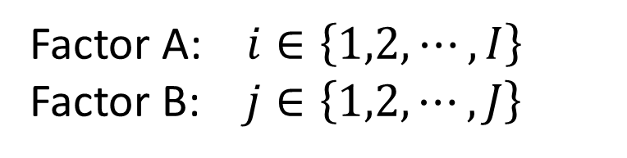
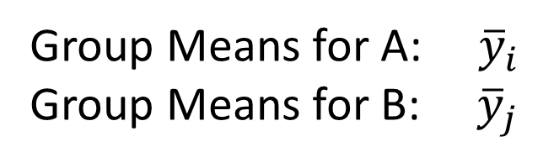
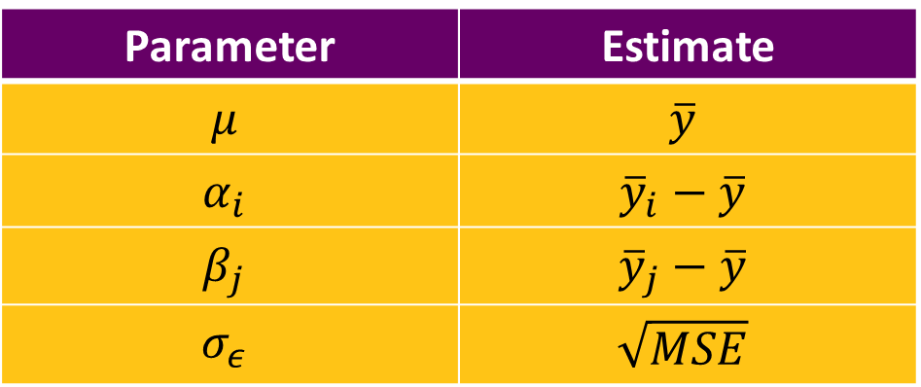
Two-Way ANOVA
Model
Estimation of Model
Factor A: $i∈\left\{1,2, ⋯,I\right\}$
Factor B: $j∈\left\{1,2, ⋯,J\right\}$
$$Y=μ+α_{i}+β_{j}+ε$$
Parameter | Estimate
$$μ$$ | $$\overline{y}$$
$$α_{i}$$ | $${\overline{y}}_{i}−\overline{y}$$
$$β_{j}$$ | $${\overline{y}}_{j}−\overline{y}$$
$$σ_{ε}$$ | $$\sqrt{MSE}$$
Group Means for A: ${\overline{y}}_{i}$
Group Means for B: ${\overline{y}}_{j}$

Slide 6
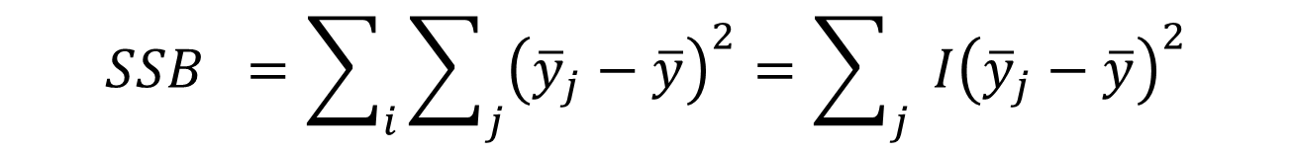
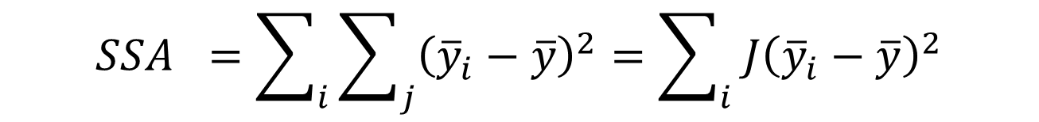

Two-Way ANOVA
Partition of Variation
$$SST =\sum_{i}{\sum_{j}{{\left(y_{ij}−\overline{y}\right)}^{2}}}=\left(n−1\right)s^{2}$$
$$SSA =\sum_{i}{\sum_{j}{{\left({\overline{y}}_{i}−\overline{y}\right)}^{2}}}=\sum_{i}{ J{\left({\overline{y}}_{i}−\overline{y}\right)}^{2}}$$
$$SSB =\sum_{i}{\sum_{j}{{\left({\overline{y}}_{j}−\overline{y}\right)}^{2}}}=\sum_{j}{ I{\left({\overline{y}}_{j}−\overline{y}\right)}^{2}}$$
$$SSE=SST−SSA−SSB$$

Slide 7
Example: Diet Programs
adf

Slide 8
Thank You
Make Reasonable Decisions

